Slide 1

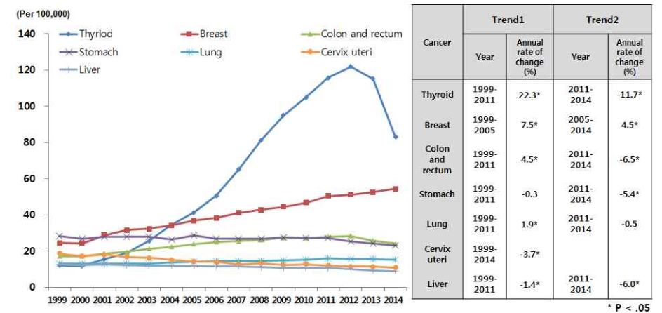
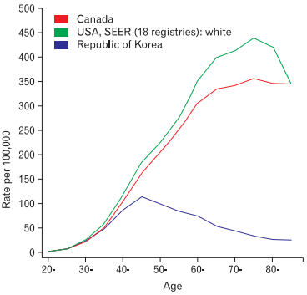
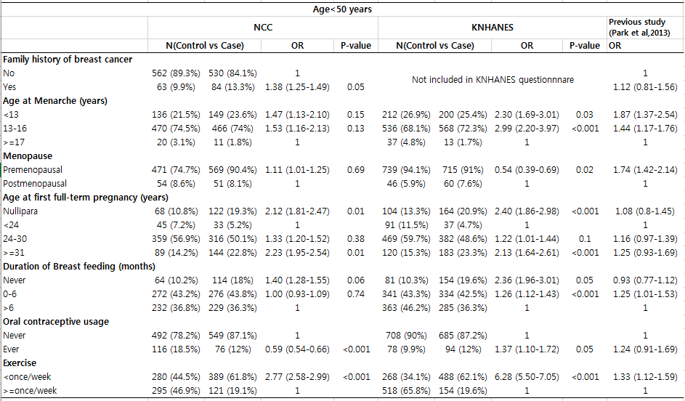
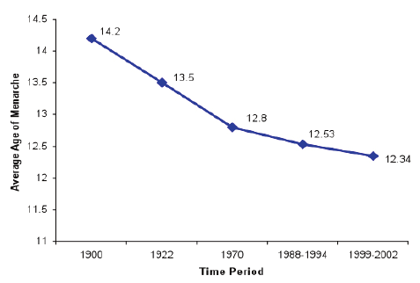
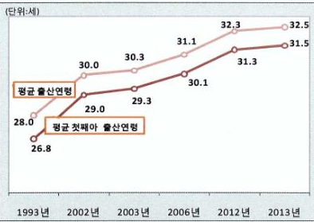
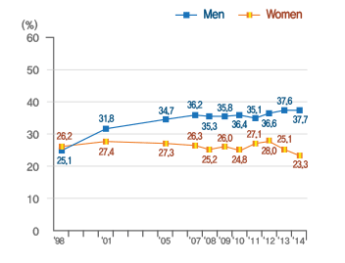
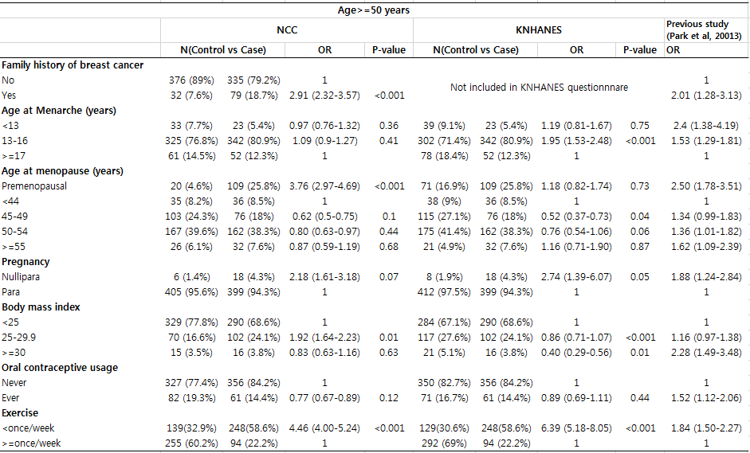
Changes in risk factors of breast cancer and its effect on breast cancer risk in Korean females
In Wook Baek¹, Eun-Sook Lee², Sun-Young Kong¹, So-Youn Jung², See youn Lee², Jeongseon Kim¹, Boyoung Park¹
¹⁾ National Cancer Center graduate School of Cancer Science and Policy
²⁾ Breast Cancer Center, National Cancer Center
BACKGROUND
RESULTS
Female breast cancer incidence has shown continuously increasing trend in Korea population and unlike Western population, breast cancer incidence at younger age is higher in Korea population
Several major risk factors of breast cancer including reproductive factors and lifestyle factors has been changed rapidly
Considering that an odds ratio (OR), is a relative term based on a distribution of a risk factor in two groups, previous OR for breast cancer might be changed as the changes of the distribution of major risk factors.
Effects of known risk factors and theirs strength of the association between hospital base case-control study and hospital base case- population base control study and a previous study Park et al.
Use multivariate logistic regression and bootstrapping 3000times to obtain robust results
Age at menarche
Age of delivery
Obesity
PURPOSE OF THIS STUDY
To compare the effects of known risk factors and theirs strength of the association between previously published Korean breast cancer case-control study results which was conducted in late 1990s and early 2000s and newly constructing case-control study results
To compare the strength of the association between hospital base case-control study and hospital base case- population base control study to measure the amount of selection bias related with control selection
PARTICIPANTS and METHODS
Data and Study population
Hospital base case-control study
- Breast cancer patients recruited from NCC between 2012.4~2017.3
- Health examinee controls recruited from NCC between 2012.4~2016.9
Hospital based case- population base controls study
- Breast cancer patients recruited from NCC between 2012.4~2017.3
- 2013~2015 Korea National Health and Nutrition Examination Survey
Separate datasets by the two age groups, less than 50 and above 50 and handling each datasets considering different risk factors etiology before and after menopause
Cases and controls were matched by 5-year age group (Hospital base case-control study) and residence area and 5-year age group (Hospital based case- population base controls study)
Assessment
By structured questionnaire
Female related : age at menarche, age at menopause, pregnancy, age at first pregnancy, duration of breast feeding, oral contraceptive usage
Confounders: age, region(only for KNHANES), educational levels(only for KNHANES).
Other demographic and socioeconomic characteristics: Body Mass Index (BMI), family history of breast cancer
NCC
(N=3853)
KNHANES
(N=12537)
CONCLUSIONS
In the case of breast cancer patients, include only incident cases
N=2654
No cancer history
Living in Urban area
(N=5436)
In general, the direction and magnitude ORs of selected breast cancer risk factors were comparable with the previous results in NCC cases-controls, except for oral contraceptive use which showed reverse association or non-significant association.
Some variables related to pregnancy, like age of first delivery, duration of breast feeding show higher odds ratio than odds ratio of previous study. This can be related to change of lifestyles.
When the ORs were compared between two types of controls, the magnitude ORs were higher in population base control
- Expected selection bias of hospital base controls would be minimal and population base controls may show higher selection bias
- In case-control study, source of cases and controls should be same to avoid biased results
There may be better model by adjusting cut offs of explanatory variables or selecting new variables, cause some variables reflect change of lifestyles and were not significant (Ex: age at menopause)
Matching by 1:1 ratio according to 5 years age categories
Matching by 1:1 ratio according to 5 years age categories
Age < 50
Control=631
Case=631
Age >= 50
Control=423
Case=423
Age < 50
Control=786
Case=786
Age >= 50
Control=423
Case=423
Acknowledgement
This study was supported by a Control from the National Cancer Center of Korea (#1710171)

